Slide 1
Support Vector Machine
Data Sets: bankloan.csv and petrol_consumption.csv

Slide 2
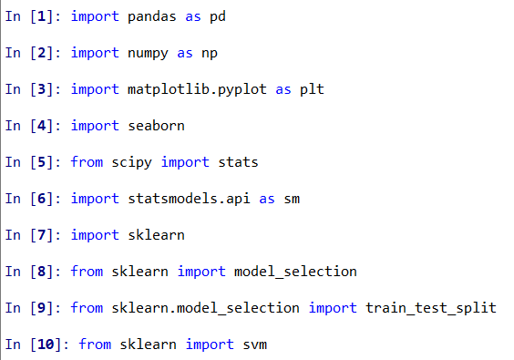
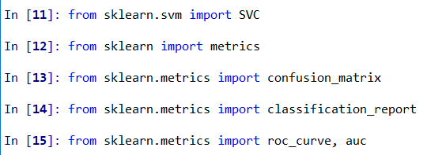
Call necessary packages

Slide 3
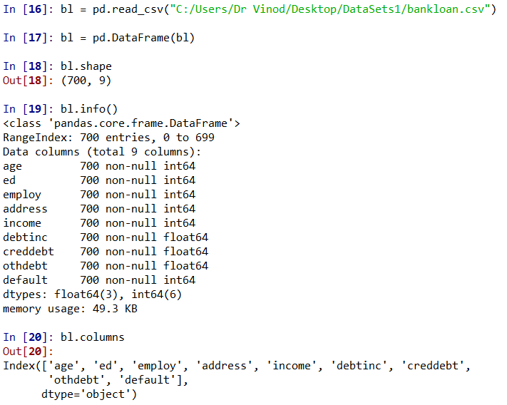
Import Data

Slide 4
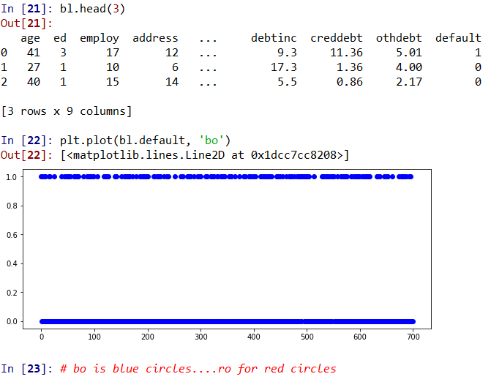
Plot default

Slide 5
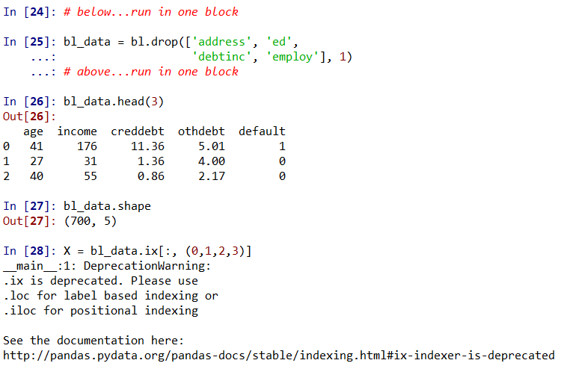
Input Variables
Lets drop these

Slide 6
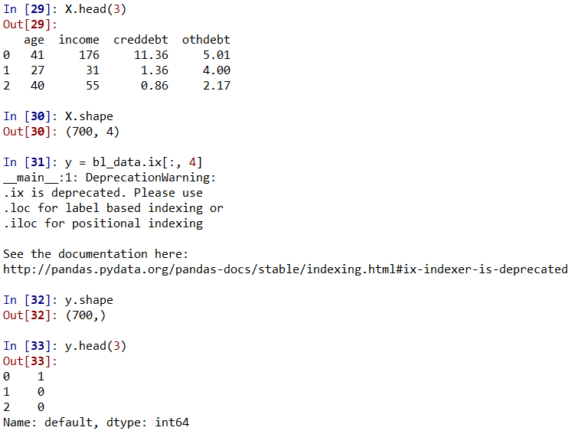
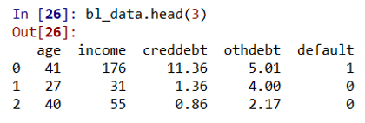
X and y
Response variable

Slide 7
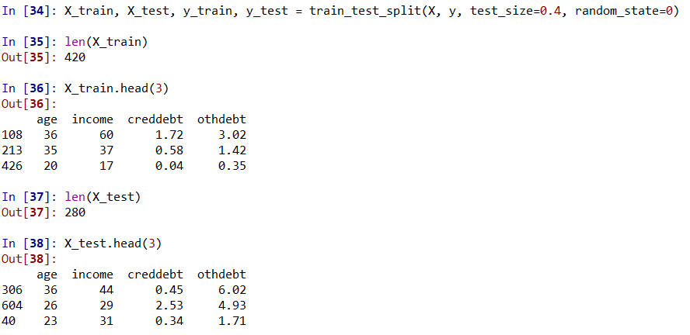
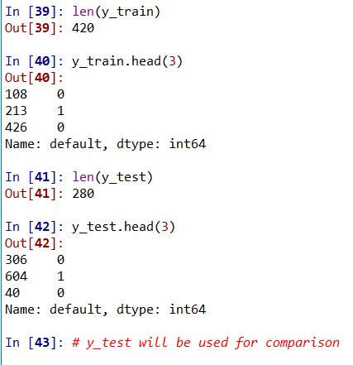
Training and Testing data sets

Slide 8
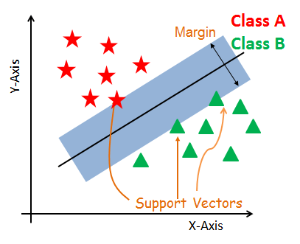
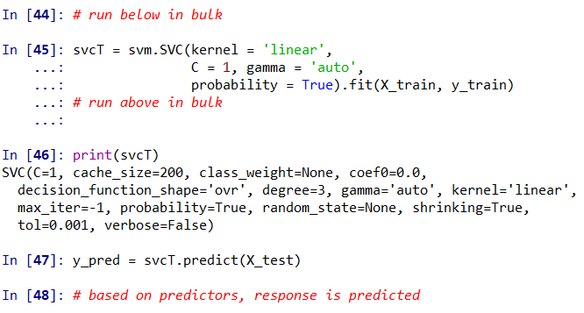
Building Model on Training set
Linear is the kernel. Others are: rbf, sigmoid, poly
C = 1, C is penalty parameter, default is 1.
It trades off between maximum distance (margin) between separating planes and correct classifications.

Slide 9
Building Model on Training set
Kernel coefficient for poly, rbf and sigmoid. áuto’will find suitable coefficient value
We want probabilities to be calculated for ROC curve

Slide 10
Building Model on Training set
Cache_size is the size of kernel cache (in MB)
Class_weight is used for giving more weights to less numbered class.

Slide 11
Building Model on Training set
Independent term in kernel function. Only applicable in ‘poly’ and ‘sigmoid’
‘ovr’ stands for one versus rest. Shape is no's of samples and no's of classes.
Applicable in ‘poly’only by default = 3
None means np.random

Slide 12
Building Model on Training set
If verbose = True, detailed logging information will come making printing slower. Default is False
It penalizes variables which do not contribute significantly in classification
Stopping criterion

Slide 13
Do Prediction

Slide 14
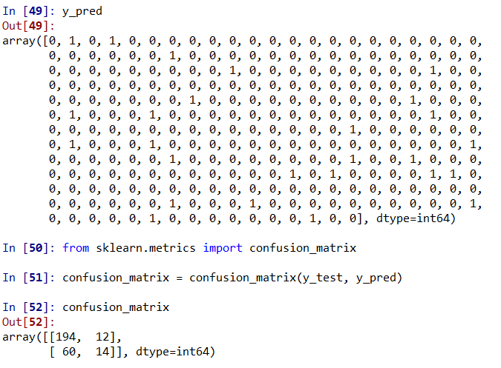
Predicted values and Classification Matrix

Slide 15
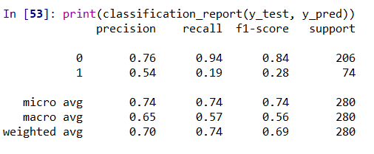
Precision, recall and f1 score

Slide 16
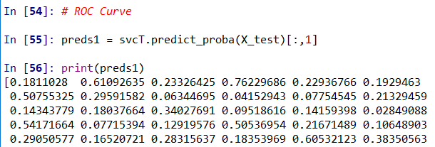

Predicted Probabilities

Slide 17
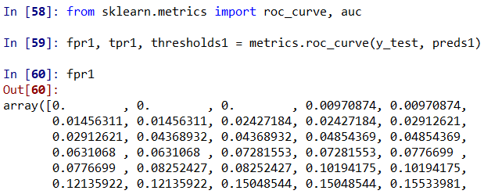
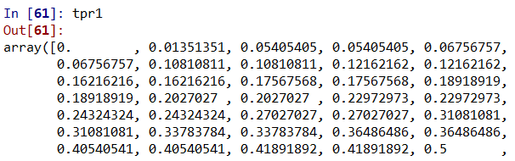
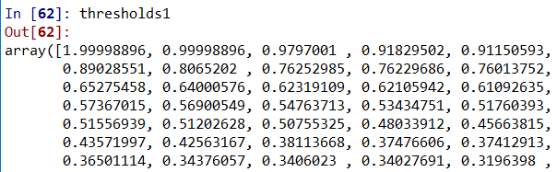
False Positive Rate, True Positive Rate & Threshold

Slide 18
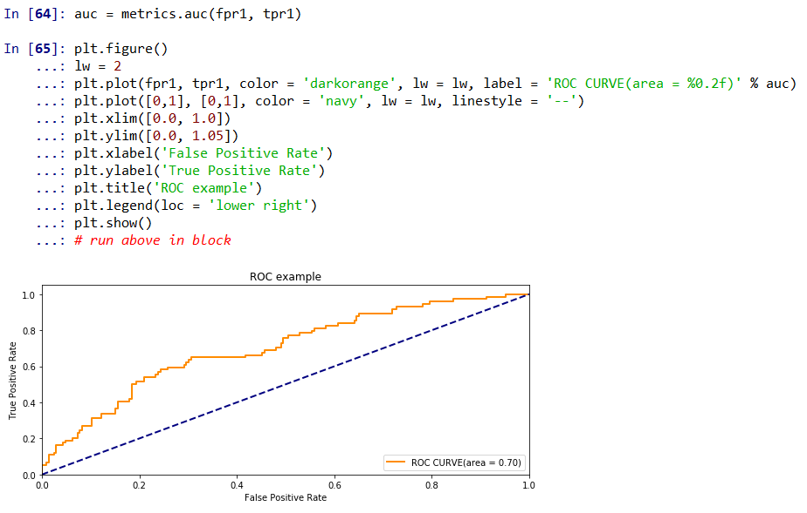
ROC Curve

Slide 19
Prediction

Slide 20
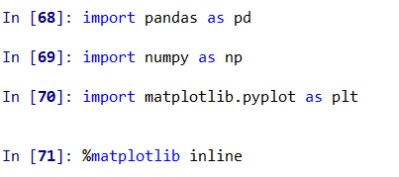
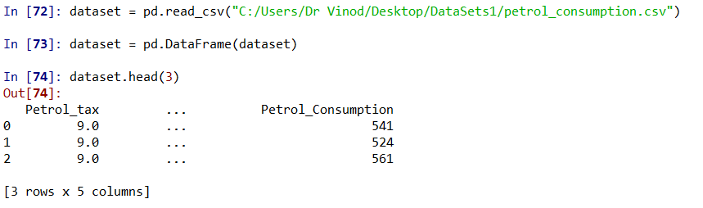
Ignore lines 65, 66 and 67
Import data

Slide 21
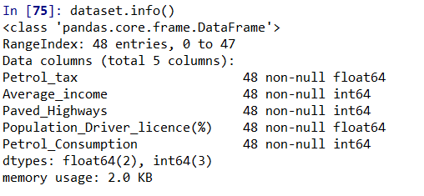
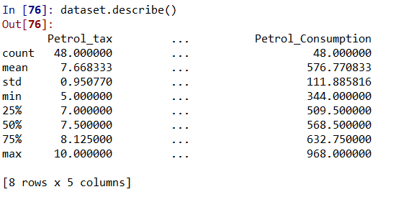
See data

Slide 22
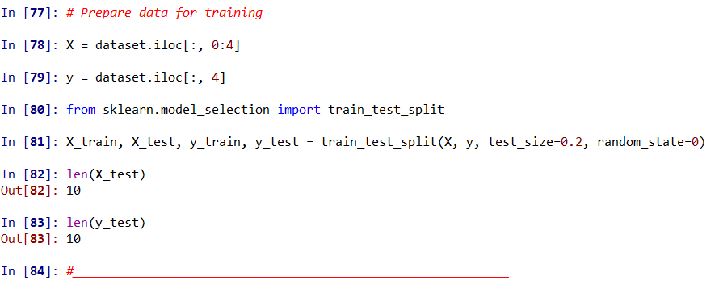
Train & Test data set

Slide 23
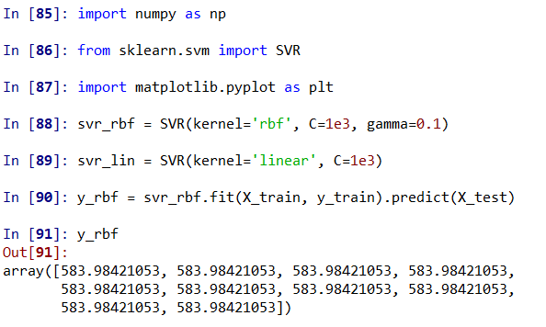
Kernel = rbf

Slide 24
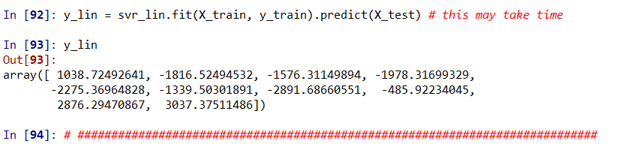
Kernel = linear

Slide 25
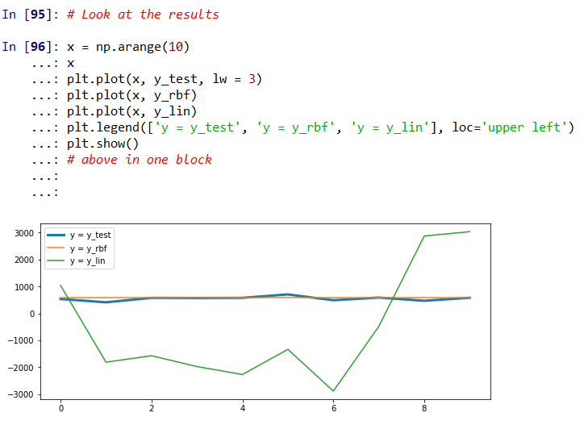
Compare rbf versus linear

Slide 26
Enjoy Learning!

